Slide 1
Smart Gloves for Handicapped People

Slide 2

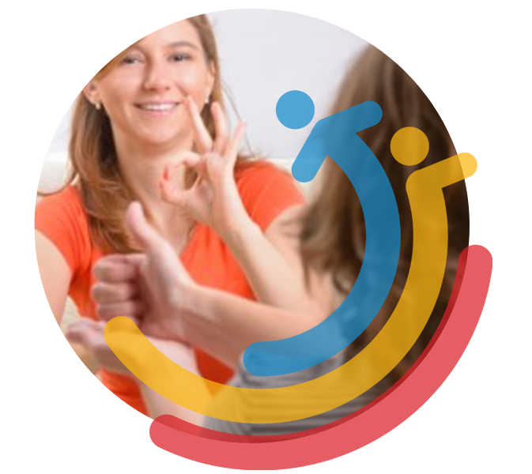
ABSTRACT
People with disabilities in the world do not fully participate in society because of their physical dysfunctions. The aim of this project is to use the sign language as a tool for the handover of the hand gestures to the text and voice.

Slide 3
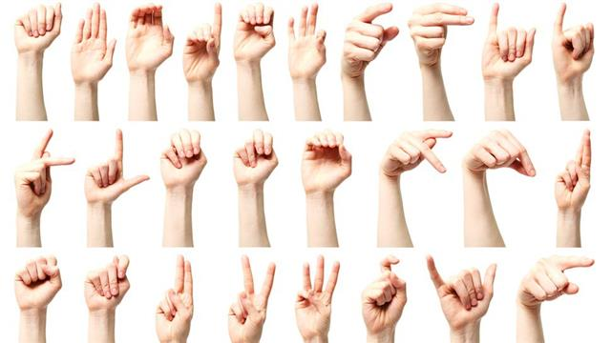
PROBLEM
Communication has been one of our most important needs throughout human history. Unfortunately, people with disabilities are having difficulty in this situation. Sign language is the best solution for this problem but most of people do not know sign language.

Slide 4

AIM OF PROJECT
The purpose of this project is to facilitate the lives of people with disabilities, enable them to communicate and to prevent them from being excluded from the society.

Slide 5
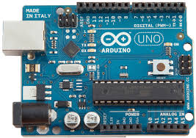
HYPOTHESIS
In this project, we can use a Arduino and we need flex sensors for every fingers. The most important reason for Arduino to be preferred in this project is the Arduino libraries, which enable everyone to program without requiring detailed knowledge of the microcontroller. We can assemble that to a basic gloves.

Slide 6
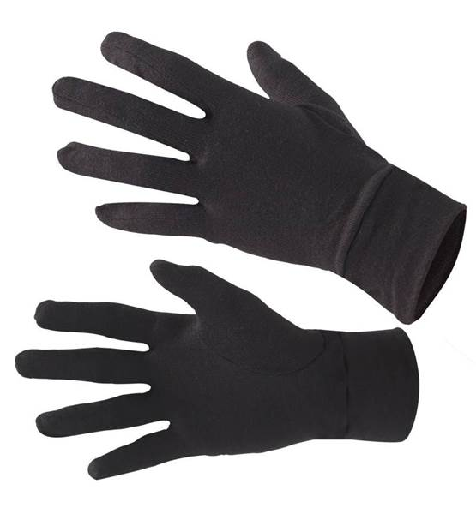
The first part is the glove we will wear. The glove has separate Flex sensors for each finger. Flex sensors resitances increase on the sensor as they flex. The glove also has an IMU sensor to distinguish between one glove's right, left, down, and up position changes. According to the common data received from the Flex sensor and IMU, the movement of our hands is transferred to the second part of the screen and speaker as a word.

Slide 7
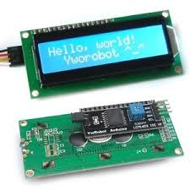
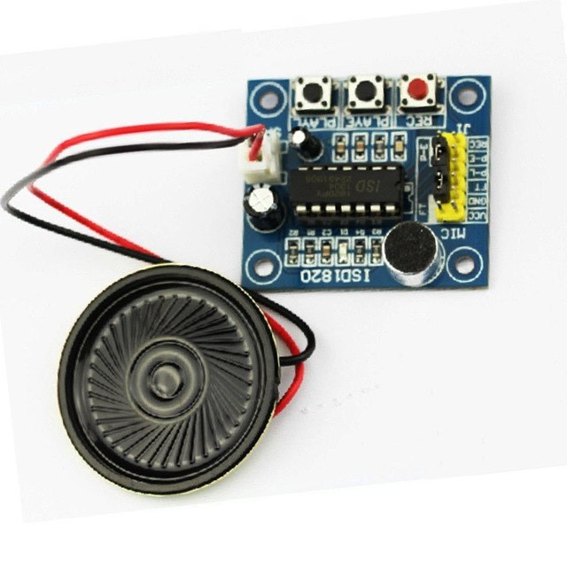
The second part of the project consists of a display and a loudspeaker. According to the information from the sensors in the first part, output operations are performed in this section. The words appear as writing on the screen, and the sound from the speaker. To record the sound extraction process, we need an SD card. These gloves can make it easier for people with speech impaired to communicate.

